Slide 1
The Transformer
Attention Based Sequence Transduction
Andreas Köpf, andreas.koepf@provisio.com
Sep 2019

Slide 2
About Me
Andreas Köpf, software developer, age 39
10+ years: hands-on experience in AI/ML, neural networks
My company: PROVISIO GmbH, creator of self-service and digital signage software SiteKiosk, offices in Münster & Miami, USA.
Last 4 years: Team leader at Xamla – adaptive robotics, developed Rosvita Robot Programming IDE & industrial robotics projects
Currently exploring: Video prediction, model based RL

Slide 3
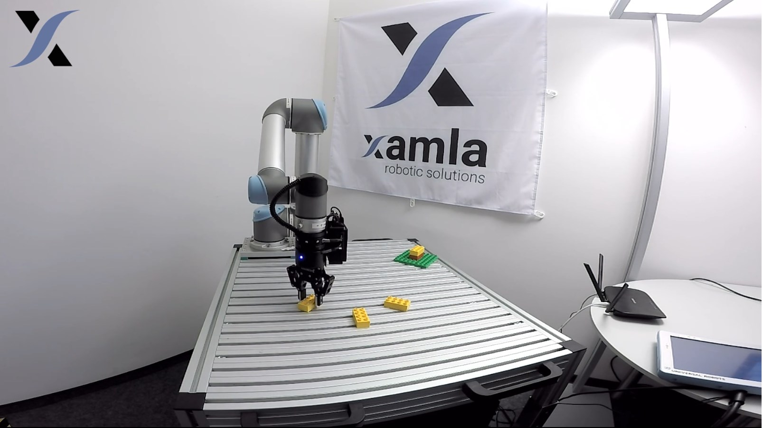
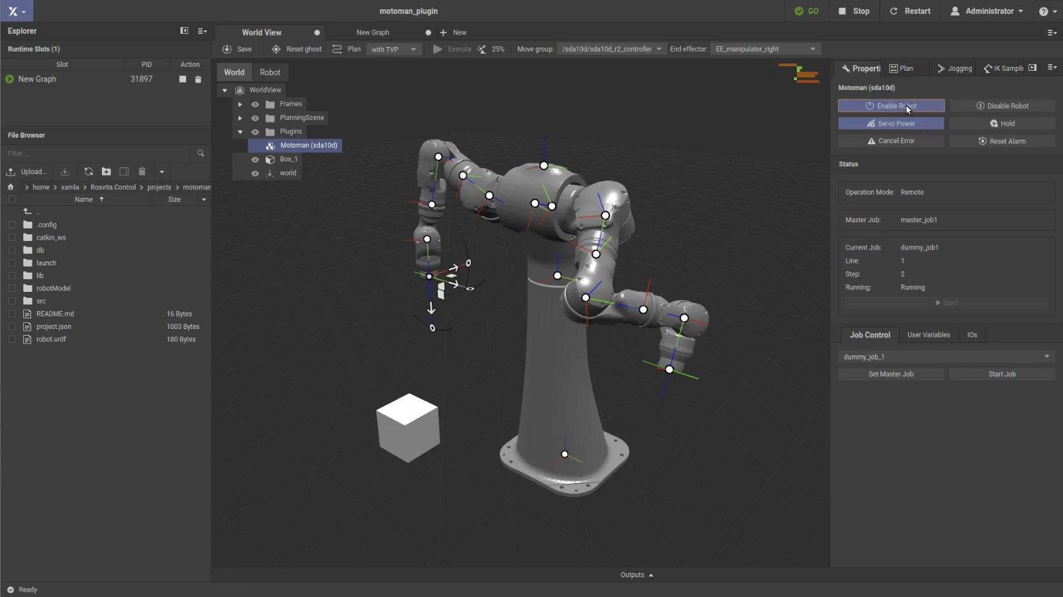
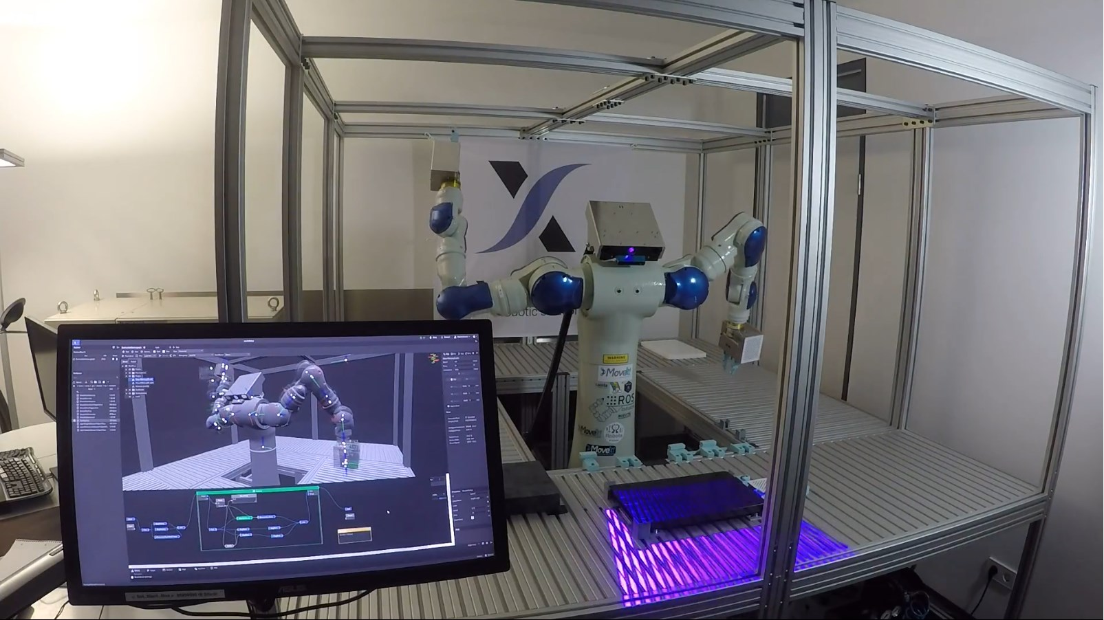
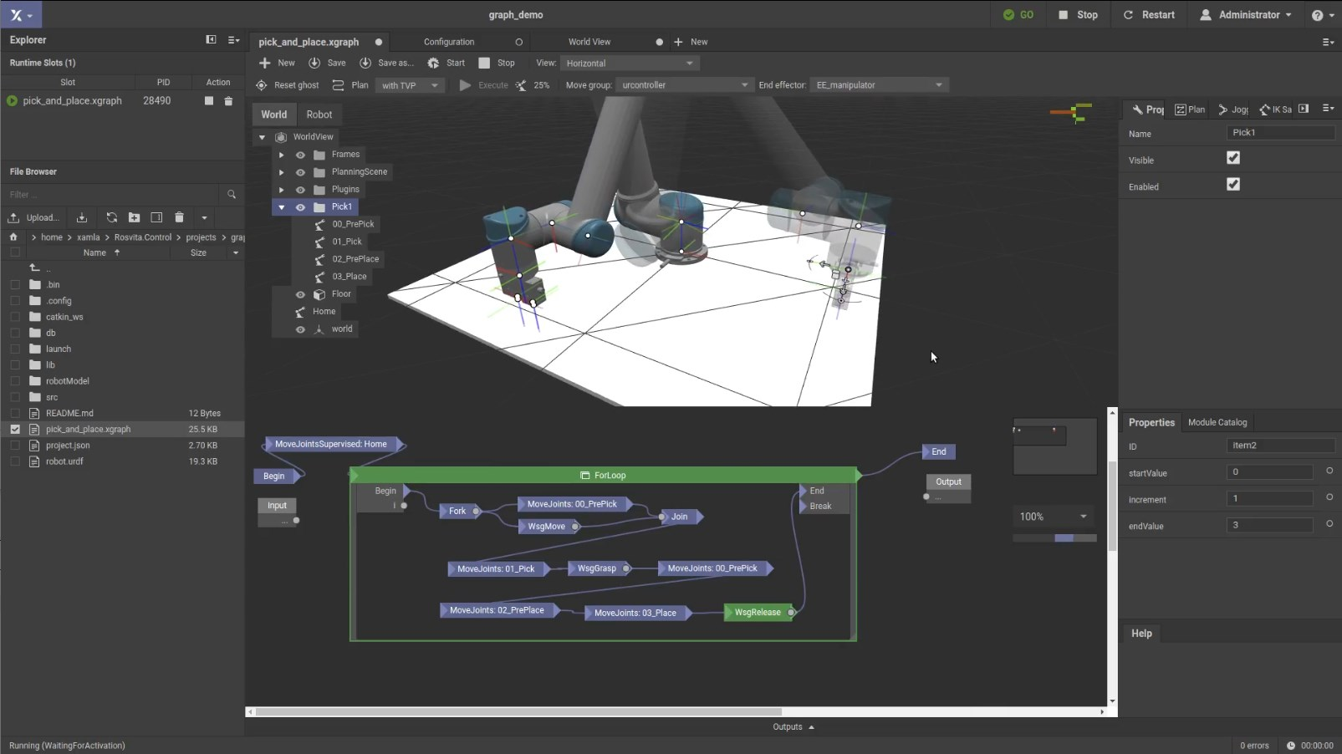
Xamla & Rosvita

Slide 4
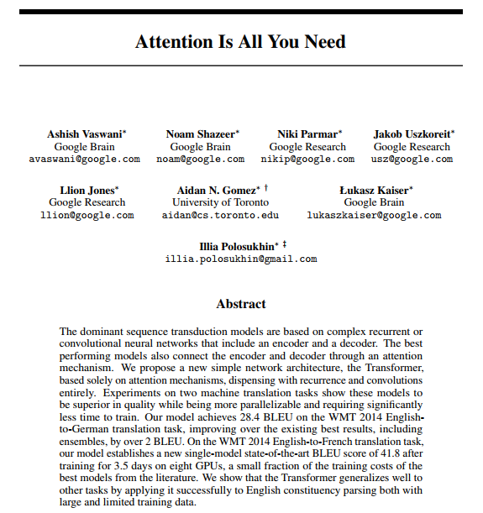
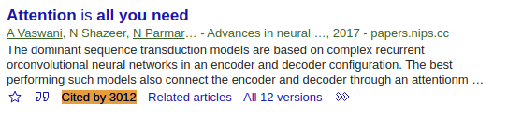


The Transformer
A sequence-to-sequence neural network architecture
Paper „Attention is all you need“, by Google 2017
Simple: Attention, feed-forward & normalization, no recurrent structure
Fast: Whole sequence processed at once -> less training time
Powerful: Improved translation quality over previous models
Basis for newer pre-trained models: BERT & GPT-2
https://arxiv.org/abs/1706.03762
Google Scholar, 2019-09-06

Slide 5
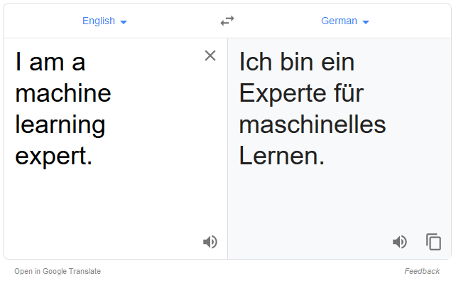

Slide 6
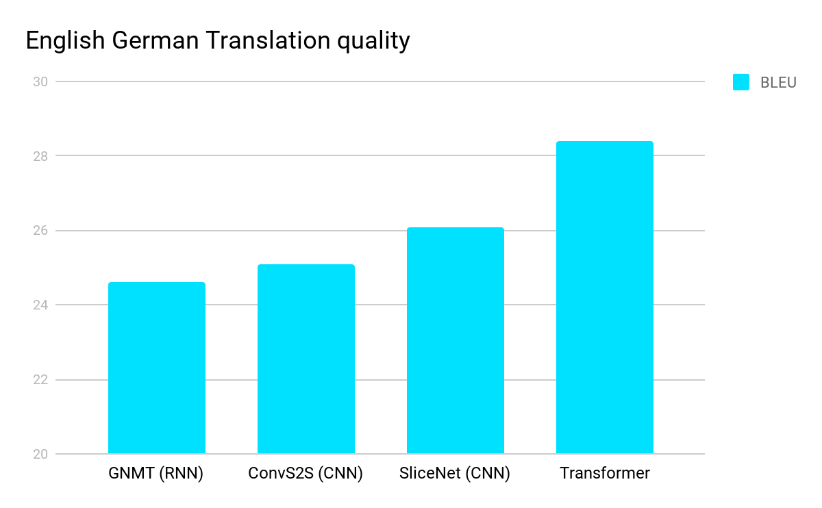

Transformer vs LSTM
[source]
Baseline: GNMT (2016) “LSTM network with 8 encoder and 8 decoder layers using attention and residual connections”
[source]

Slide 7
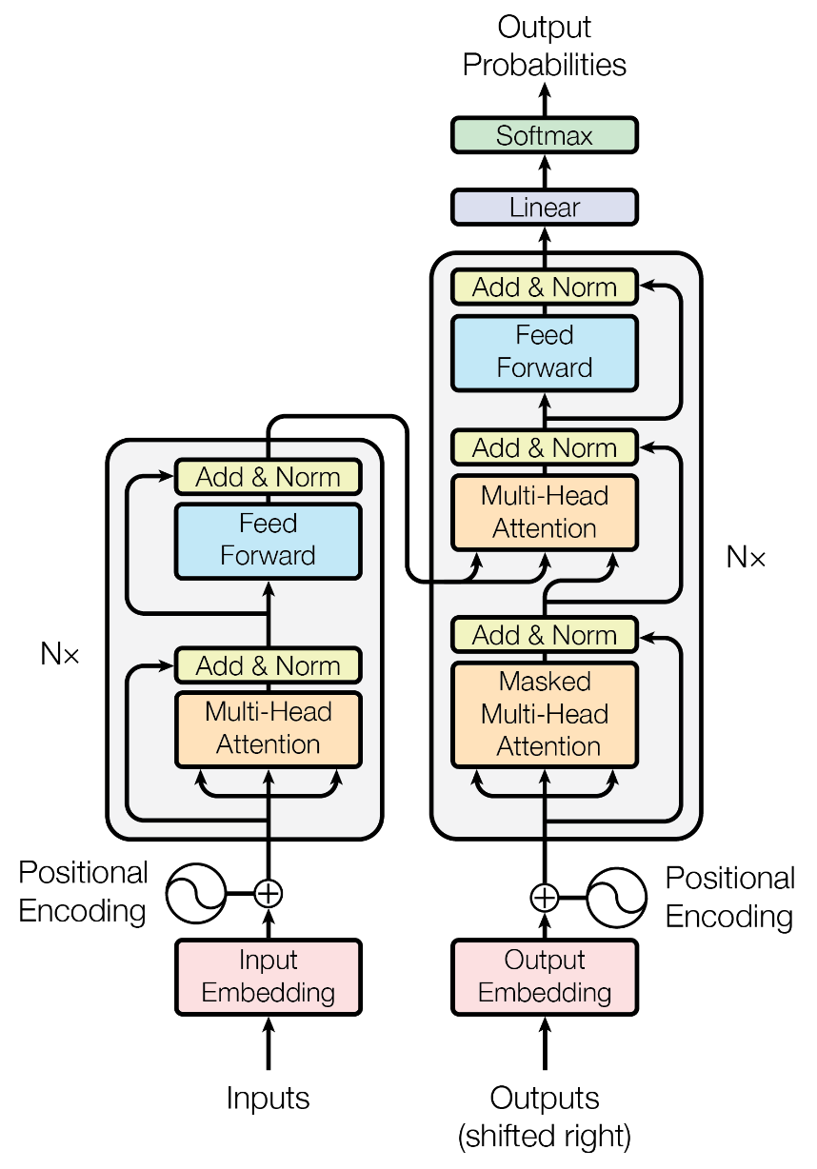
Key Components
Encoder & Decoder
Input Embedding
Next Token Classifier
Auto-Regressive Decoder
Encoder-Decoder Attention
Self-Attention
Feed-Forward Layer
Residual & Normalization
Positional Encoding

Slide 8
Key Components
Encoder & Decoder
Input Embedding
Next Token Classifier
Auto-Regressive Decoder
Encoder-Decoder Attention
Self-Attention
Feed-Forward Layer
Residual & Normalization
Positional Encoding

Slide 9
Key Components
Encoder & Decoder
Input Embedding
Next Token Classifier
Auto-Regressive Decoder
Encoder-Decoder Attention
Self-Attention
Feed-Forward Layer
Residual & Normalization
Positional Encoding

Slide 10
Encoder & Decoder
INPUT
Encoder
Decoder
OUTPUT
How are you
Wie geht es dir
Sequence Embedding
Conditional Language Model

Slide 11
Key Components
Encoder & Decoder
Input Embedding
Next Token Classifier
Auto-Regressive Decoder
Encoder-Decoder Attention
Self-Attention
Feed-Forward Layer
Residual & Normalization
Positional Encoding

Slide 12
Input Embedding
INPUT
Encoder
Decoder
OUTPUT
Wie geht es dir
how
are
you
aaa
aaron
vocabulary size
50,000
abby
Split text into tokens, e.g. words, sub-words (BPE)
Convert tokens into vectors using a lookup-table
Learn representation during training
…
…
…
zzy
embedding size
512

Slide 13
Key Components
Encoder & Decoder
Input Embedding
Next Token Classifier
Auto-Regressive Decoder
Encoder-Decoder Attention
Self-Attention
Feed-Forward Layer
Residual & Normalization
Positional Encoding

Slide 14
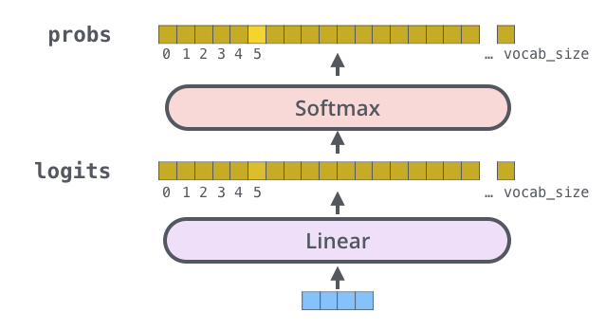
Next Token Classifier
50,000
50,000
Decoder output
512
OUTPUT
INPUT
Encoder
Decoder
how
are
you
wie
geht
es
dir
</s>
Decoder output is projected to vocabulary size logits vector
Softmax step gives token probabilities
Weight matrix of embeddings & pre-softmax output projection may be tied

Slide 15
Key Components
Encoder & Decoder
Input Embedding
Next Token Classifier
Autoregressive Decoder
Encoder-Decoder Attention
Self-Attention
Feed-Forward Layer
Residual & Normalization
Positional Encoding

Slide 16
Autoregressive Decoder
OUTPUT PROBABILITIES
Sample
Encoder
Decoder
dir
how
are
you
<s>
wie
geht
es
INPUT EMBEDDING
OUTPUT EMBEDDING

Slide 17
Key Components
Encoder & Decoder
Input Embedding
Next Token Classifier
Autoregressive Decoder
Encoder-Decoder Attention
Self-Attention
Feed-Forward Layer
Residual & Normalization
Positional Encoding

Slide 18
Encoder-Decoder Attention Mechanism
Intuition
Math View
Focus on relevant source words while generating a target word
Decide which information enters “working memory”
Allow the decoder to attend over all positions in the input sequence (in one step)
A form of differentiable soft memory read and transform operation
Extraction of fixed sized vectors from variable length memory

Slide 19
History of Encoder-Decoder Attention
Sequence-to-Sequence RNN without attention:
Input sequence had to be “compressed” into context vector
Problem: Long computational path between input & output
y₁
y₂
y₃
…
y_{m}
DECODER
<s>
y₁
y₂
y₃
Context Vector
ENCODER
x₁
x₂
x₃
…
x_{n}

Slide 20
History of Encoder-Decoder Attention
RNN with attention:
Attention layer “augments” hidden states of the decoder
Decoder “reads” values from the encoder (based on its state)
y₁
y₂
y₃
…
y_{m}
DECODER
<s>
y₁
y₂
y₃
Attention mechanism: read from relevant positions
h₁
h₂
h₃
…
h_{n}
Memory
ENCODER
x₁
x₂
x₃
…
x_{n}

Slide 21
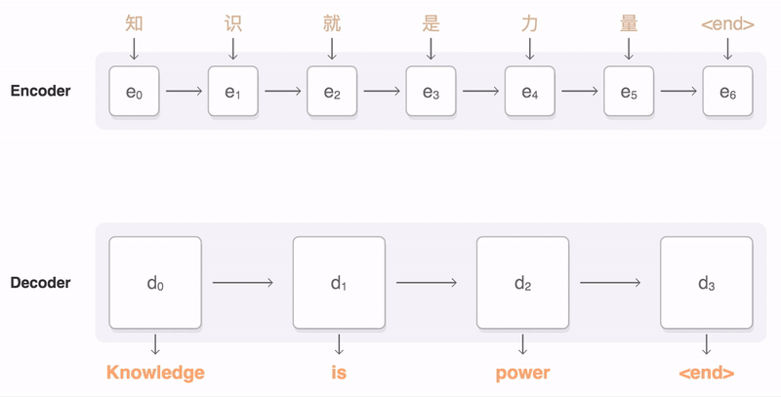
Source: https://ai.googleblog.com/2016/09/a-neural-network-for-machine.html

Slide 22
Encoder-Decoder Attention
Encoder Output
Feed Forward
Feed Forward
En-/Decoder Attention
Decoder Block
(repeated N times)
Encoder Block
(repeated N times)
Self-Attention
Masked Self-Attention
how
are
you
<s>
wie
geht
es
dir

Slide 23
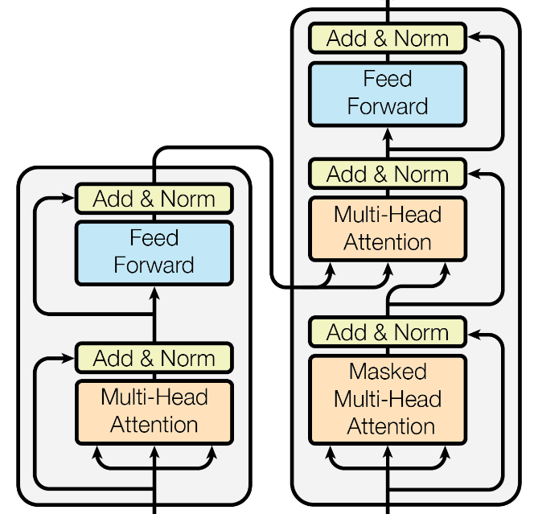
Attention
Attention layers have three inputs:
Key, Value & Query (K, V, Q)
k1
v1
q1
k2
v2
q2
k3
v3
q3
q4
Key
Value
Query

Slide 24
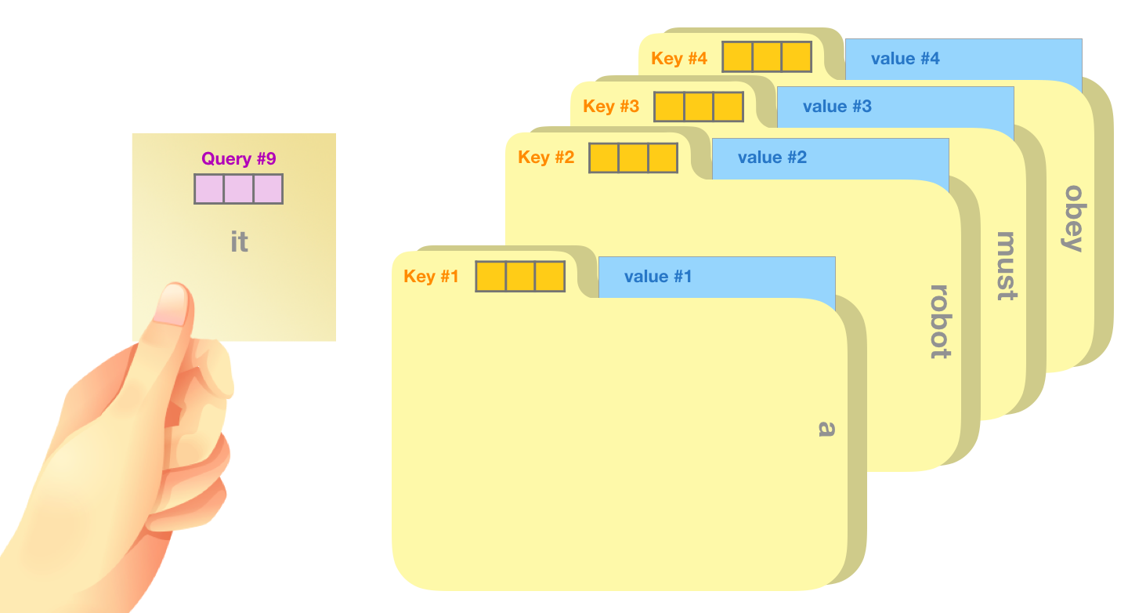
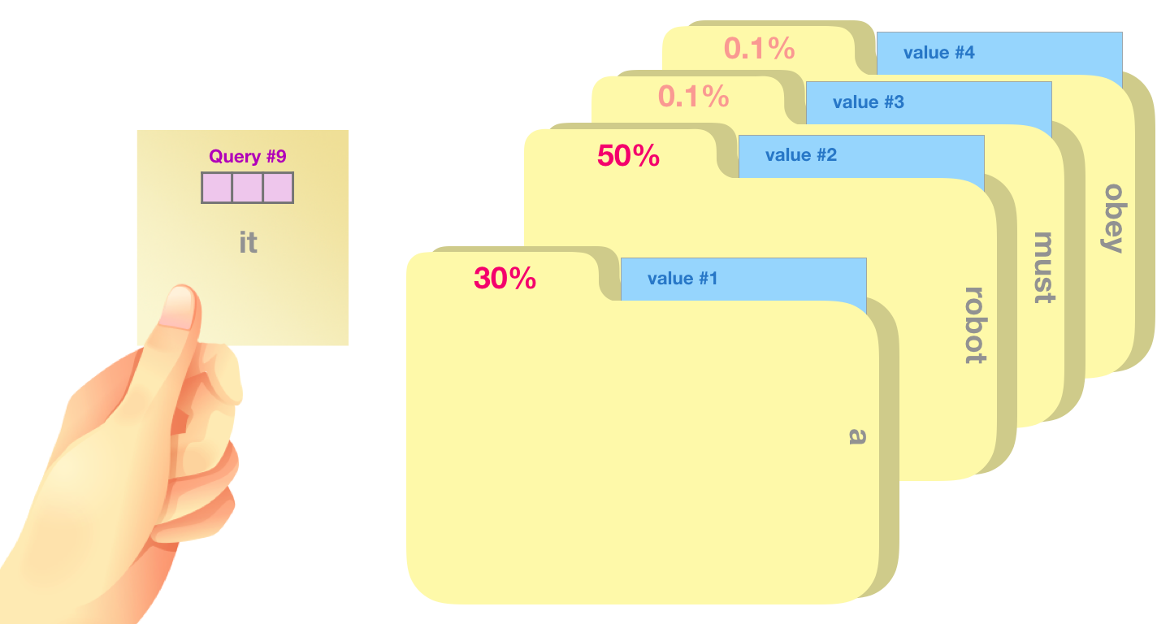
Attention
k1
v1
q1
k2
v2
q2
Attention computes a soft Key - Value based mapping of Query elements.
Each Key k_{i} corresponds to Value v_{i}, as in a lookup-table / dictionary
Attention is like a memory read op: Mem content: Value Mem addresses: Keys Read addresses: Query
-> Transformer uses a soft, differentiable Attention mechanism!
k3
v3
q3
q4
Key
Value
Query

Slide 25

Scaled Dot Product Attention
k1
v1
q1
The similarity of each Query vector to all Key vectors is measured via dot-product.
These similarity-scores are passed through softmax to determine the contribution of each Value element to the output.
A weighted average of Value rows is computed based on the softmax output.
k2
v2
q2
k3
v3
q3
q4
Key
Value
Query
Scaling compensate “variance gain”,
lowers softmax temperature,
helps gradient flow

Slide 26
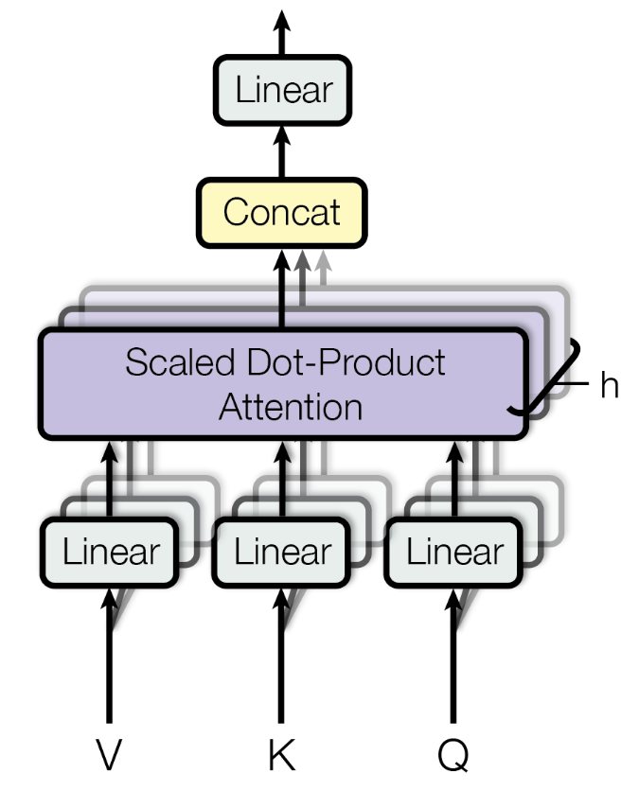
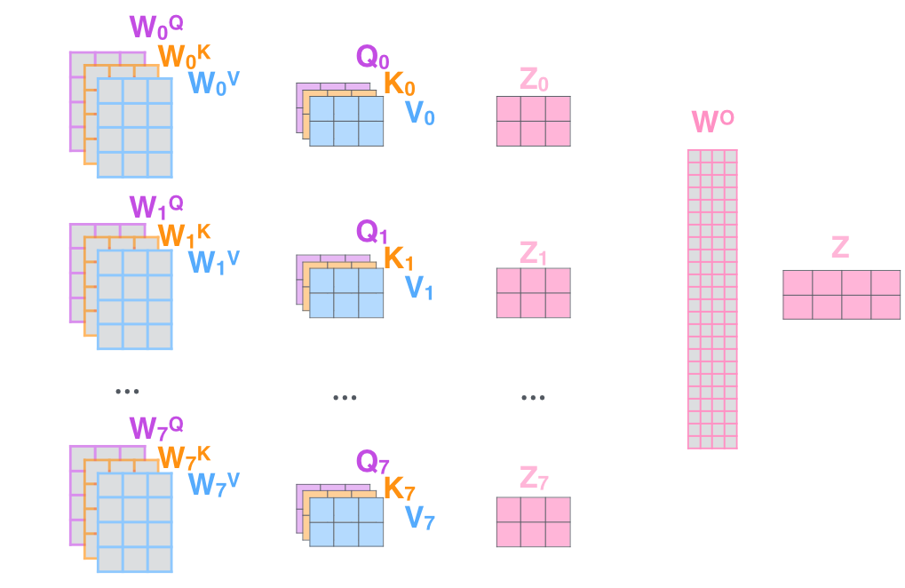
Multi-head Attention
Perform multiple attention functions in parallel: “attention heads”
Linearly project Key, Value and Query multiple times (with different weights) for each “head”
Finally concat all outputs and project once again
Low overhead if V, K, Q are projected to lower dimensionality (e.g. d_{k} = d_{model} / h)

Slide 27
Key Components
Encoder & Decoder
Input Embedding
Next Token Classifier
Autoregressive Decoder
Encoder-Decoder Attention
Self-Attention
Feed-Forward Layer
Residual & Normalization
Positional Encoding

Slide 28
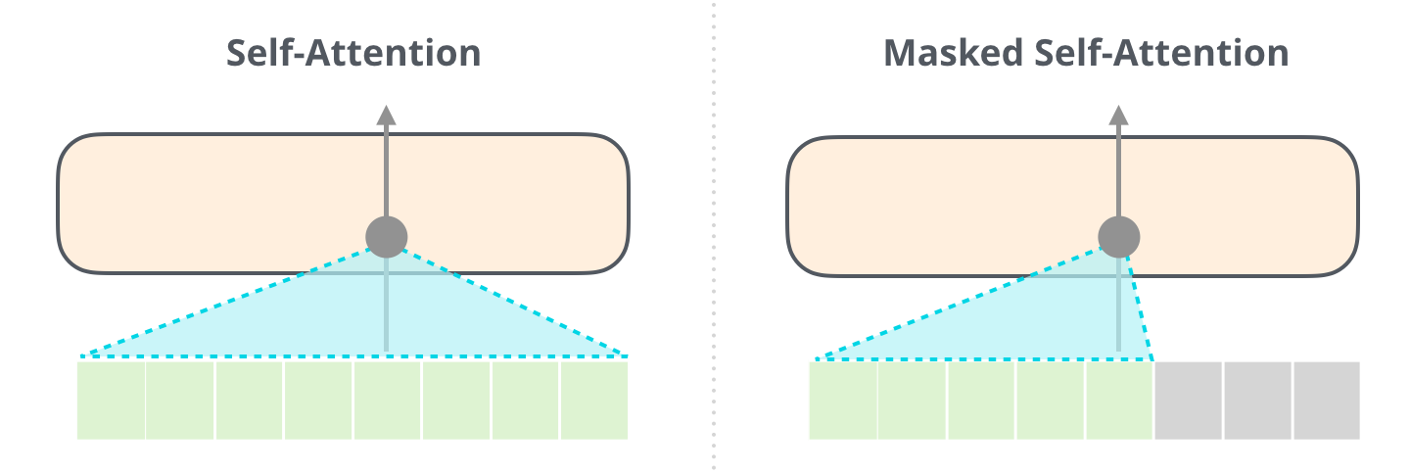
Self-Attention
Key, Value and Query inputs of a Self-Attention layer are all the same: multi_head_attention(x, x, x)
Create context dependent representations: word -> thought vector
Relate with all positions of the input sequence in one step
Masked Self-Attention: Let decoder only attend to past outputs (masks out all (future) sequence elements to the right of a token
e.g. fill with -1e9 before softmax
[image source]

Slide 29
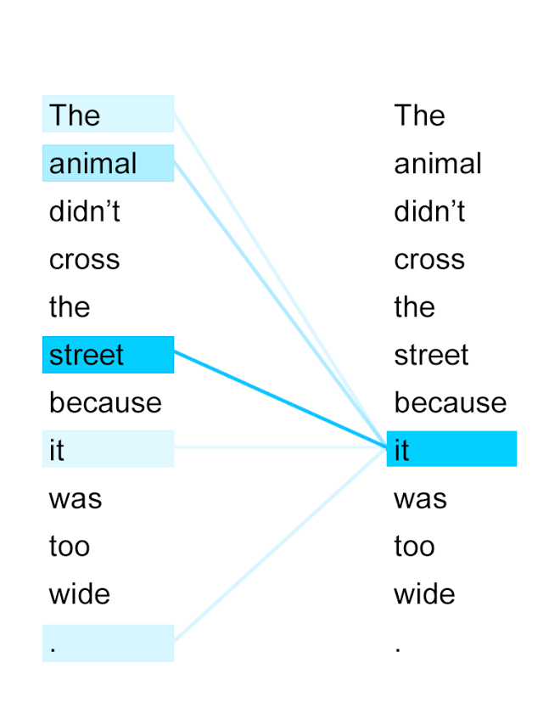
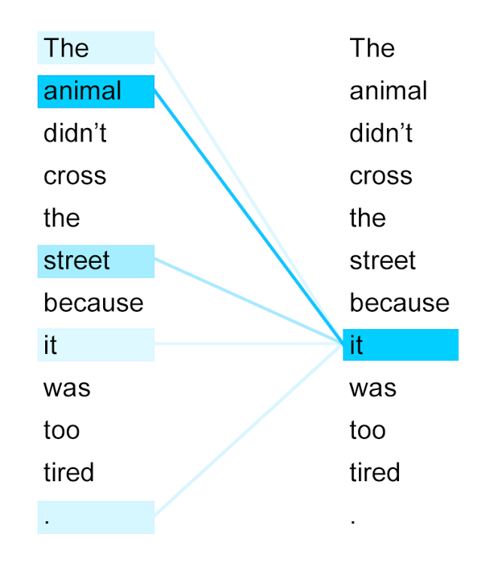
Self-Attention

Slide 30
Key Components
Encoder & Decoder
Input Embedding
Next Token Classifier
Autoregressive Decoder
Encoder-Decoder Attention
Self-Attention
Feed-Forward Layer
Residual & Normalization
Positional Encoding

Slide 31
Position-wise Feed-Forward Network
Two linear transformation with a ReLU activation function
Shared weights for all positions in a layer, like Conv with kernel-size 1
Different weights layer to layer
Inner layer dimensionality: d_{ff} = 4 * d_{model}
Contains ~50% of the transformer parameters
Linear
(in: 2048, out: 512)
FFN
ReLU
Linear
(in: 512, out: 2048)
Shared weights
…
Linear
…
ReLU
…
Linear
x₁
x₂
x₃
x_{n}

Slide 32
Key Components
Encoder & Decoder
Input Embedding
Next Token Classifier
Autoregressive Decoder
Encoder-Decoder Attention
Self-Attention
Feed-Forward Layer
Residual & Normalization
Positional Encoding

Slide 33

Residual & Normalization
Help avoiding vanishing gradients
Layer(x) = LayerNorm(x + Sublayer(x))
Note: All sub-layers have the same output size: d_{model}
LayerNorm: mean and variance of each element-vector is normalized independently
[Image Source]

Slide 34
Key Components
Encoder & Decoder
Input Embedding
Next Token Classifier
Autoregressive Decoder
Encoder-Decoder Attention
Self-Attention
Feed-Forward Layer
Residual & Normalization
Positional Encoding

Slide 35
Positional Encoding
OUTPUT
wie
geht
es
dir
</s>
Encoder
Decoder
Position
Position
+
+
+
+
+
+
+
+
how
are
you
<s>
wie
geht
es
dir
INPUT EMBEDDING
OUTPUT EMBEDDING

Slide 36

The Full Transformer
LayerNorm(x + SubLayer(x))
Masked: not peek at
future tokens
Encoder
Decoder
Source: https://lilianweng.github.io/lil-log/2018/06/24/attention-attention.html

Slide 37
Data Flow: Parallel Sequence Processing
Feed Forward
Feed Forward
Encoder Attention
Self-Attention
Masked Self-Attention

Slide 38

Selected Resources: Go And Transform
Fun:
https://talktotransformer.com/
https://transformer.huggingface.co/ (Write With Transformer)
Blogs:
http://jalammar.github.io/
http://nlp.seas.harvard.edu/2018/04/03/attention.html (The Annotated Transformer)
https://lilianweng.github.io/lil-log/2018/06/24/attention-attention.html
PyTorch:
https://huggingface.co/pytorch-transformers/
https://github.com/pytorch/fairseq
https://docs.fast.ai/text.models.html
Tensorflow:
https://www.tensorflow.org/beta/tutorials/text/transformer
https://github.com/google-research/bert

Slide 39
Questions?
Thanks for your attention! ;-)

Slide 40
Bonus Slides

Slide 41
GPT-2 Sample Text
"The Transformer" is a story about a young inventor's attempt to win a competition to see who can build and develop a robot that can drive a car. His robot will be more powerful than other designs.
The robot is named Mimi. It uses a three-cylinder engine which will allow it to achieve speeds on the open road that would otherwise be impossible. The Transformer will also have the ability to drive and accelerate on its own. Mimi will only drive after being charged with an electric current. Each charge will generate enough electricity to accelerate the robot up to a top speed of 20 mph. The Transformer could be driven from the garage and charged in a matter of seconds when the battery is depleted. The Transformer utilizes a special battery pack designed specifically for Mimi and can run for several months without charging.
Each Transformer is designed to look similar to a toy and includes an eye-catching LED headlights. The Transformer's wheels are also painted a bright orange color and the Transformer can also travel backward in time if it gets lost.
Generated by https://talktotransformer.com/

Slide 42
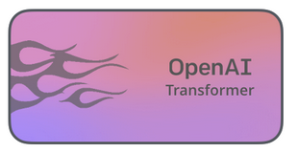
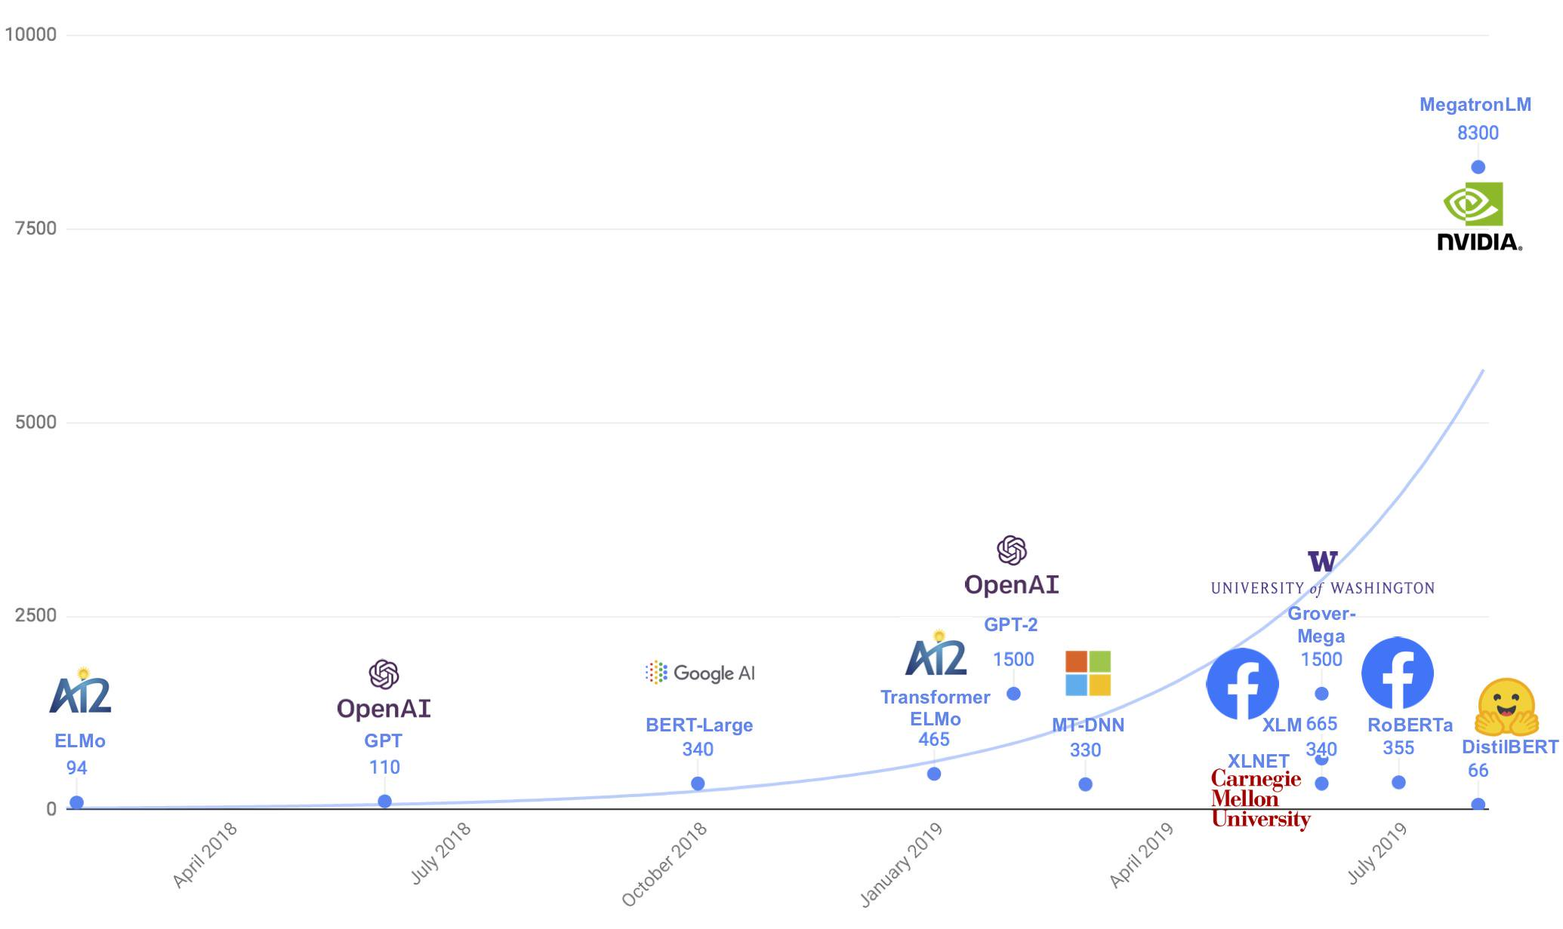
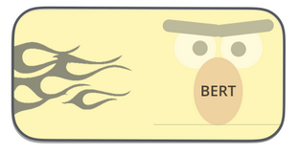
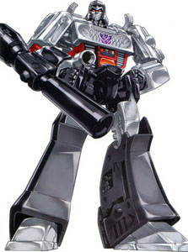
The Offspring
Model Parameters (Mio)
Nvidia: “Scaling the model to 8.3 billion parameters on 512 GPUs….”
https://nv-adlr.github.io/MegatronLM
Sources:
https://medium.com/huggingface/distilbert-8cf3380435b5
https://jalammar.github.io/illustrated-bert/

Slide 43

Data Flow: Multilayer Encoder & Decoder

Slide 44
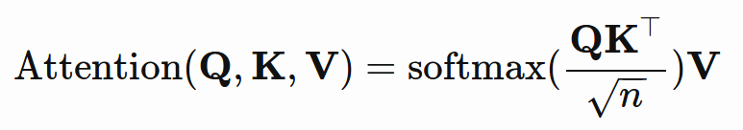
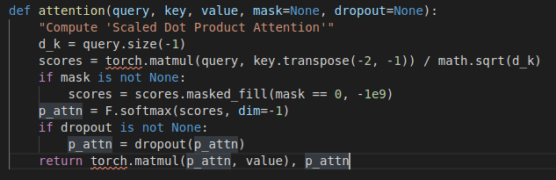
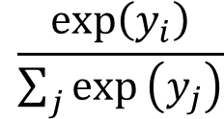
Scaled Dot Product Attention
Q: Query
K: Key
V: Value
Z: Output
row-wise
Scaling factor, lowers softmax ‘temperature’
$$\frac{exp\left(y_{i}\right)}{\sum_{j}{exp}\left(y_{j}\right)}$$

Slide 45
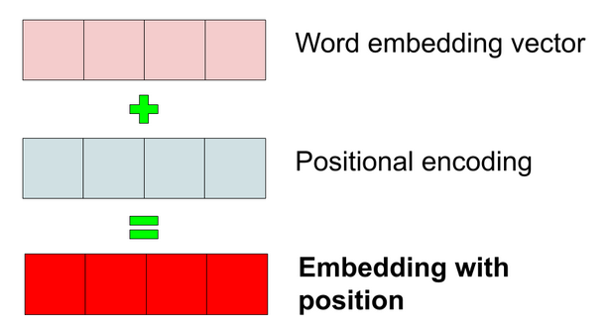
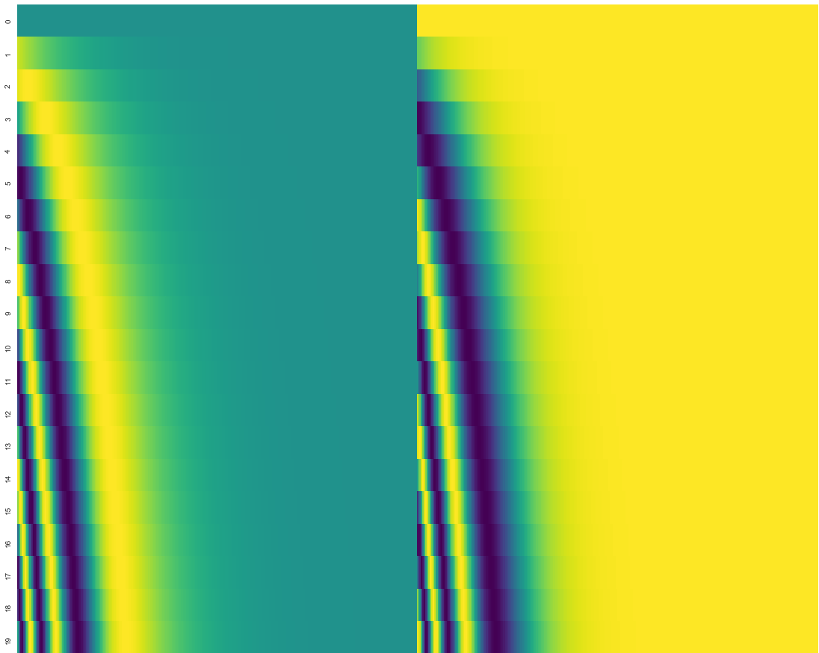
Positional Encoding
Problem: Model is invariant to input order: En-/Decoder attention is omnidirectional
Solution: Add vector to each input element to inject position information
Encoding can be learned or hard-coded via fixed formulas
Fixed encoding may help to attend by relative positions
Position
Embedding dim
Encoding for pos 10

Slide 46
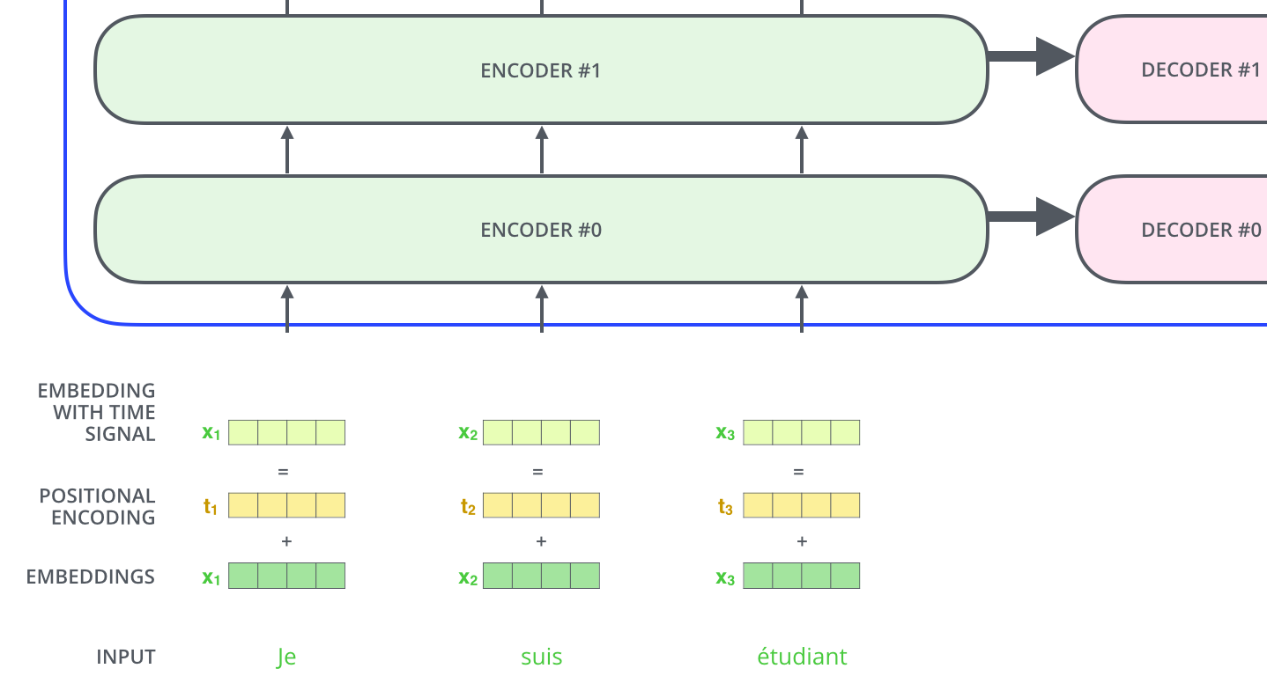
Positional Encoding
Source: http://jalammar.github.io/illustrated-transformer/

Slide 47
Decoding Strategies
Greedy Search pick most likely next token
Beam Search keep a fixed number (beam-width) of candidates per step
Top-k Sampling sample from distribution of top-k probabilities per step
Nucleus Sampling (top-p) sample from top-slice of probability mass per step

